Slide 1
Computer Modeling and Simulation
By
Sara Rehmat
MS(CS)

Slide 2
Petri Nets

Slide 3
Discrete Event Systems
A Discrete Event System (DES) is a dynamic system whose behavior is characterized by abrupt changes in the value of its state, which takes discrete values, from a possibly infinite set.
The state evolution is due to the occurrence of events; in other words, a DES is a discrete-state and event-driven system

Slide 4
Modeling of DES
Petri Nets
Automata
Labeled Transition Systems
Notes:
L
<number>

Slide 5
Introduction to Petri Nets
Petri nets were introduced by C.A.Petri in the early 1960s as a mathematical tool for modeling distributed systems.
Their further development was facilitated by the fact that Petri Nets easy model process synchronization, asynchronous events, concurrent operations, and conflicts or resource sharing.
Petri Nets have been successfully used for concurrent and parallel systems modeling and analysis, communication protocols, performance evaluation of fault-tolerant systems.

Slide 6
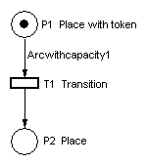
Graphical Representation of Petri Nets
A Petri Net is a collection of directed arcs connecting places and transitions.
Places may hold tokens.
The presence or absence of a token in a place can indicate whether a condition associated with this place is true or false.
The state or marking of a net is its assignment of tokens to places.
Arcs have capacity 1 by default; if other than 1, the capacity is marked on the arc. Places have infinite capacity by default, and transitions have no capacity, and cannot store tokens at all.
The arcs can only connect places to transitions and vice versa.
Here is a simple net containing all components of a Petri Net:

Slide 7
Transitions in Petri Nets
A transition is enabled when the number of tokens in each of its input places is at least equal to the arc weight going from the place to the transition.
An enabled transition may fire at any time.
When a transition fires, it takes the tokens that enabled it from the input places; it then distributes tokens to output places according to arc weights.
If the arc weights are all the same, it appears that tokens are moved across the transition. If they differ, however, it appears that tokens may disappear or be created.
The firing of a transition results in a new marking of the net, a state description of all places.

Slide 8
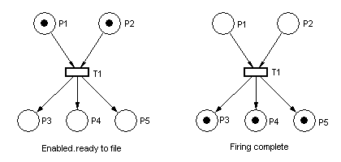
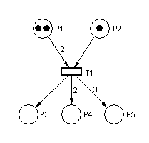
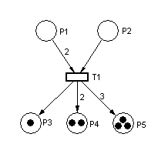
Transition in Petri Nets

Slide 9
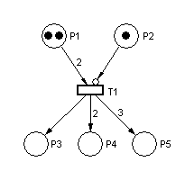
Transition in Petri Nets
A special kind of arc, the inhibitor arc, is used to reverse the logic of an input place. With an inhibitor arc, the absence of a token in the input place enables, not the presence. This transition cannot fire, because the token in P2 inhibits it.

Slide 10
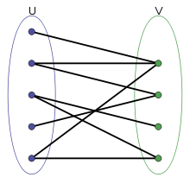
Mathematical Definition Of Petri Nets
A Petri net is a particular kind of bipartite directed graphs.
A bipartite is a graph whose vertices can be divided into two disjoint and independent sets U and V such that every edge connects a vertex in U to one in V.

Slide 11
Mathematical Definition Of Petri Nets
A Petri net is formally defined as a 5-tuple
N = (P, T, I, O, M₀), where
P = {p1, p2, …, p_{m}} is a finite set of places;
T = {t1, t2, …, t_{n}} is a finite set of transitions, P ∪ T ≠ ∅, and P ∩ T = ∅;
I: P × T → N is an input function that defines directed arcs from places to transitions, where N is a set of non-negative integers;
O: T × P → N is an output function that defines directed arcs from transitions to places; and
M₀: P → N is the initial marking.

Slide 12
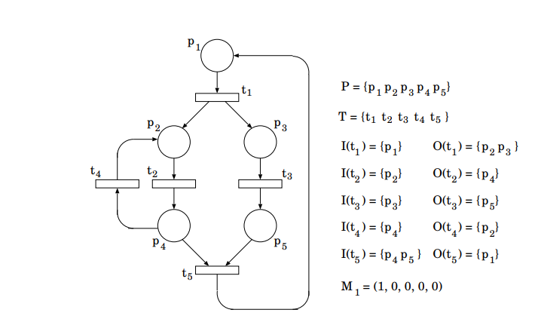
Example

Slide 13
Matrix Representation of Petri Nets
Any Petri Net can be represented as an incidence matrix.
The incidence matrix is found out in three steps.
Find D⁻ which represents for each transition the number of incoming arcs from each place.
Find D⁺ which represents for each transition the number of outgoing arcs to each place.
Find D (the composite change matrix or incidence matrix) by subtracting D⁻ from D⁺.

Slide 14
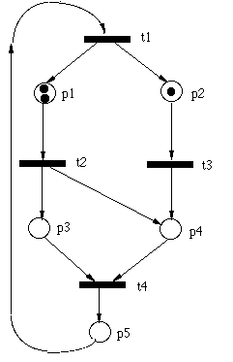
D⁻ matrix
Find the D⁻ matrix. It is an m x n (m rows, n columns) matrix, where m is the number of transitions and n is the number of places in the Petri Net.
For each position [i,j] in the matrix, place a 1 in the position if transition i has input from place j. A 0 is placed in the position if position i does not have input from place j.
D⁻ matrix for PN of Fig. 1:
0 0 0 0 1 1 0 0 0 0 0 1 0 0 0 0 0 1 1 0
Fig. 1

Slide 15
D⁺ matrix
Find the D⁺ matrix. It is an m x n (m rows, n columns) matrix, where m is the number of transitions and n is the number of places in the Petri Net.
For each position [i,j] in the matrix, place a 1 in the position if transition i has output from position j. A 0 is placed in the position if position i does not have output from position j. D⁺ matrix for PN of Fig. 1:
1 1 0 0 0 0 0 1 1 0 0 0 0 1 0 0 0 0 0 1
Fig. 1

Slide 16
D matrix
Find the D matrix (the composite change matrix). It is computed by subtracting D- from D+. (D+) - (D-) = D.
1 1 0 0 -1 -1 0 1 1 0 0 -1 0 1 0 0 0 -1 -1 1

Slide 17
Transition Matrix and Marking Matrix
A 1 x m matrix should be constructed to represent the firing of the Petri Net. In each position [1,j], place the number of times transition j is to fire. Transition matrix for Fig. 1 (assuming t2, t3 firing): [0 1 1 0]
A 1 x n matrix should be constructed to represent the current marking of the Petri Net. In each position [1,j], place the number of tokens in position j. Marking matrix for Fig. 1: [2 1 0 0 0]

Slide 18

Determining next marking from the initial marking
To determine the marking of the Petri Net after the transition(s) specified in the transition matrix, compute:
([Transition Matrix][D]) + [Marking Matrix] = [Next Marking]
Transition Matrix
D
Marking Matrix
Next Marking

Slide 19
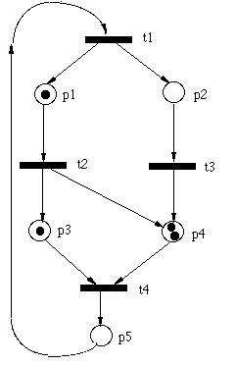
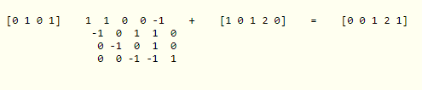
Determining next marking from the previous marking
Transition matrix for Fig. 2 (assuming t2, t4 firing): [0 1 0 1]
Marking matrix for Fig. 2: [1 0 1 2 0]
([Transition Matrix][D]) + [Marking Matrix] = [Next Marking]
Fig. 2

Slide 20
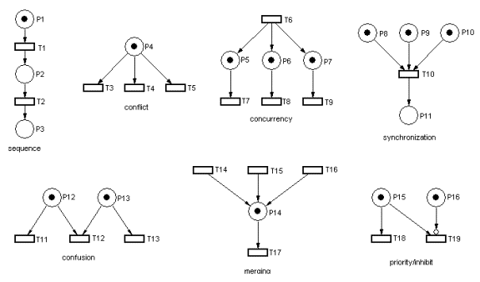
Petri Nets for Modeling Primitive Structures

Slide 21

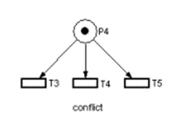
Petri Nets for Modeling Primitive Structures
In sequence several things happen in order.
In conflict, the token in P4 enables three transitions; but when one of them fires, the token is removed, leaving the remaining two disabled.

Slide 22
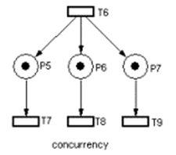
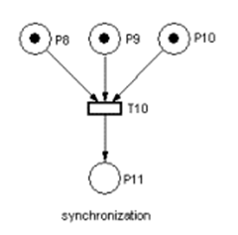
Petri Nets for Modeling Primitive Structures
In concurrency, all transitions occur at the same time.
Synchronization is also modeled well using Petri Nets; when the processes leading into P8, P9 and P10 are finished, all three are synchronized by starting P11.

Slide 23
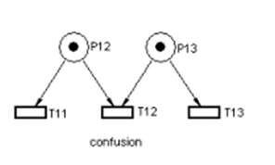
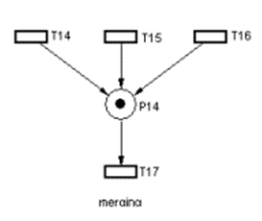
Petri Nets for Modeling Primitive Structures
Confusion is a combination of conflict and concurrency. P12 enables both T11 and T12, but if T11 fires, T12 is no longer enabled.
Merging is not quite the same as synchronization, since there is nothing requiring that the three transitions fire at the same time, or that all three fire before T17; this simply merges three parallel processes.

Slide 24
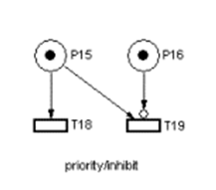
Petri Nets for Modeling Primitive Structures
The priority/inhibit construct uses the inhibit arc to control T19; as long as P16 has a token, T19 cannot fire.

Slide 25
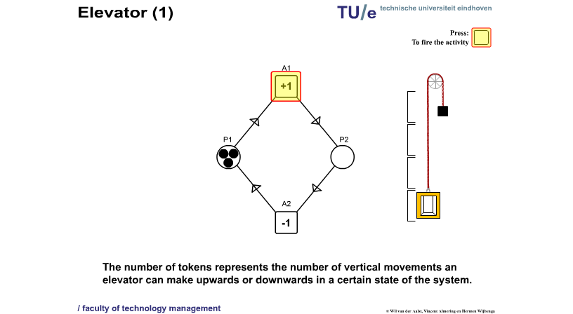
Example Petri Net for Elevator

Slide 26
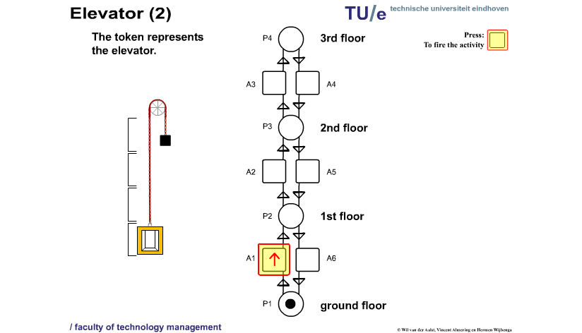
Alternate Petri Net for Elevator

Slide 27
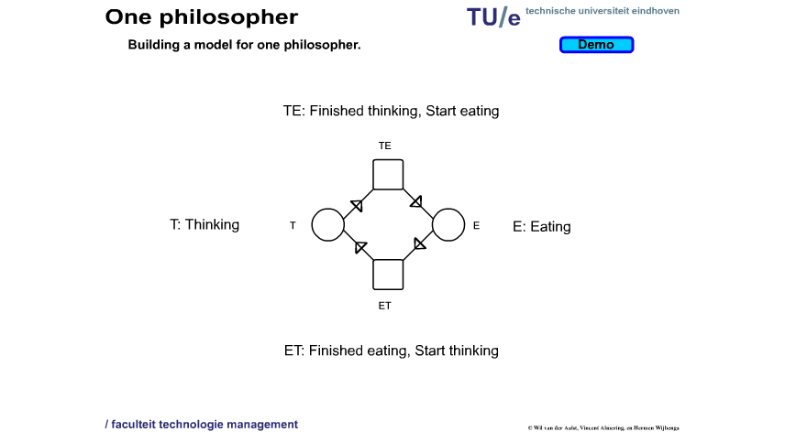
Dining Philosophers Problem – 1 Philosopher

Slide 28
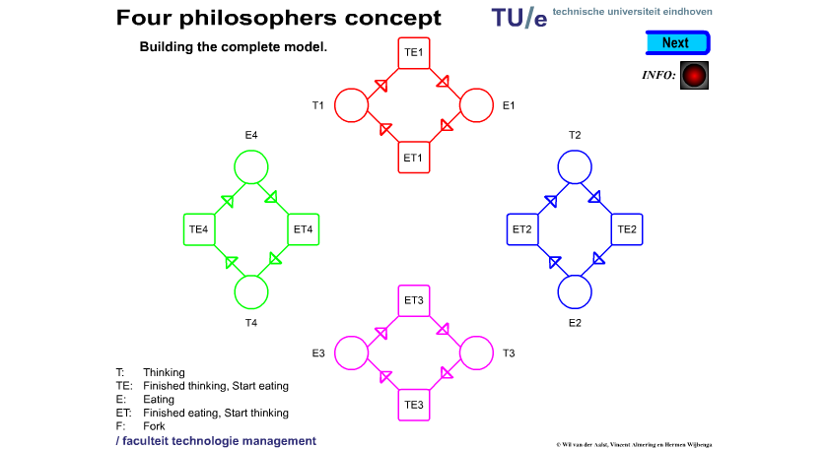
Dining Philosophers Problem - 4 Philosophers

Slide 29
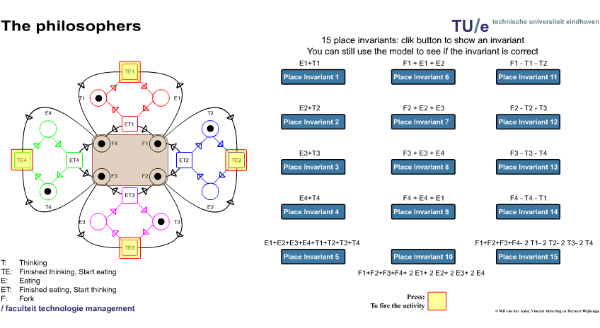
Dining Philosophers Problem - 4 Philosophers

